Slide 1
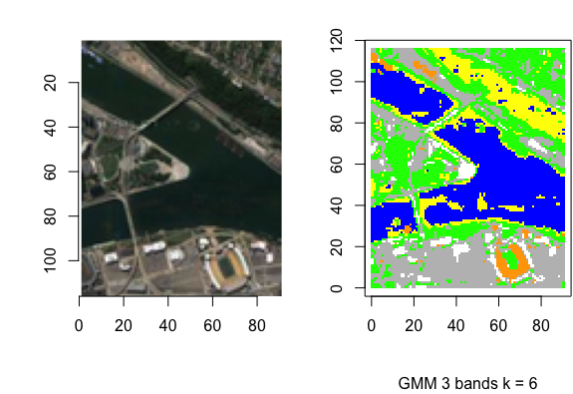
GMM Based Classification of Images
Department of Computer Science
Amit Sanjay Watve, Felix Kim, Jonathan Raynor, Omkar Pradeep Acharya, Sridutt Bhalachandra, Sean Mahaffey
North Carolina State University
1. Introduction
3. <Technical section>
5. Parameter choices
Patches of a larger image are classified into five categories: residential one, residential two, commercial, water, and vegetation. A GMM algorithm and One Rule classifier are used to create a rule based classifier that can classify patches once trained on annotated ones.
One problem with kNNs was suspected to be the need for a good distance function.
CNNs make the assumption that inputs are images.
K-L divergence is a measure of distance between distributions.
<Diagram for best performing model>
Input image -> Gaussian mixture model -> kNN to GMM templates using K-L divergence.
Number of components in Gaussian Mixture Models = ...
Patch size = ….
Initial centers for the GMM were chosen as the centers from agglomerative hierarchical clustering because….
Components in pairs of GMMs were matched using …
OR
Batch size, learning rate, learning rate decay, momentum, network architecture, activation function. Reasons for all choices.
(Note: Use bullet points, no paragraphs)
2. Data description
4. Results
6. Conclusions
<Example images/tables/graphs.>
<Describe your dataset>
Specify number of bands, any special properties.
Computing environment if worthy of mention, GPU make.
<diagrams showing the results of your method>
(For example,
For CNNs for classification, true positive, one false positive, one false negative. Learning curves for loss vs. number of iterations, training and testing accuracies vs. number of iterations.
For GMMs, a portion of the image (original and classified) that the method found hard to discriminate.
Table with performance of different methods under some accuracy measure.
Performance (qualitative or quantitative) of your methods under different parameter settings.)
<what conclusions did you draw from your semester long work>
CNNs perform the best on this task because….
Random forests beat all other methods by a huge margin because….
7. References
Few of the most important reference papers, GitHub links, whatever.
Feel free to deviate from this template and get creative to a large extent, as long as you hit all the key notes.

